Slide 1





Executive Summary
41.72 %
OLA
of booking attempts did not result in completed rides
103,024
Total Bookings
58,28%
Completed
₹ 23.7 M
Booking Value at Risk
Operational and supply-side issues are the primary drivers of ride failure

Slide 2

Business Problem
How effectively is customer demand converted into completed rides?
More than 4 in 10 booking attempts fail to convert into completed rides
58.28%
Completed

Slide 3
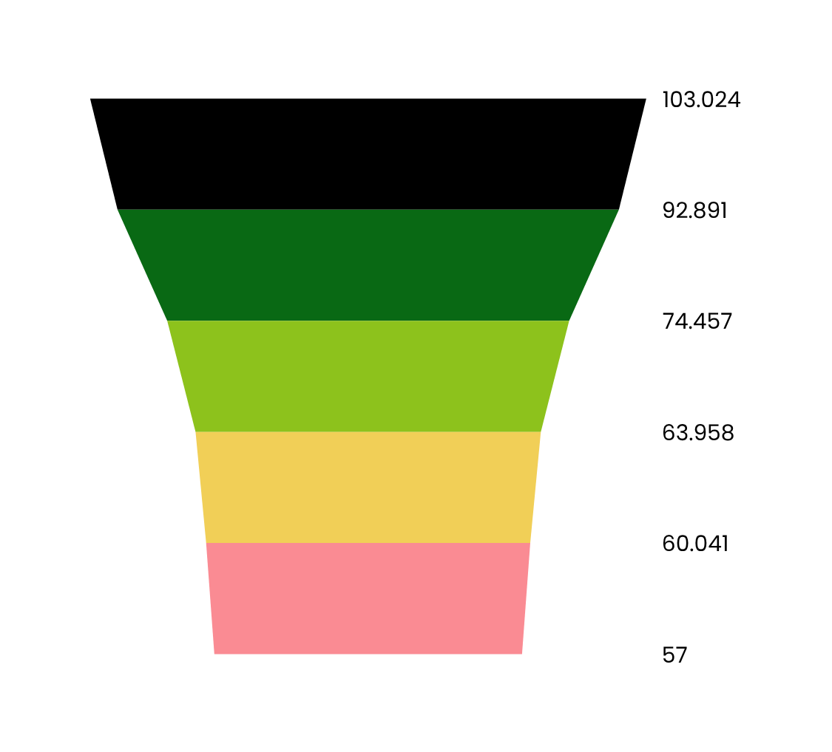

Where are Bookings Lost?
103,024
Requests
⬇10,133 Rides : Driver Not Found
92,891
Driver Matched
⬇18,434 Rides : Driver Cancelled
74,457
Driver Confirmed
⬇10,499 Rides : Customer Cancelled
63,958
Cust Confirmed
⬇3,917 Rides : Incomplete
60,041
Completed
Over 18,000 rides were lost after driver confirmation, representing the most significant drop-off stage in the booking process.

Slide 4




Business Impact
How much value is being lost?
COMPLETED BOOKING VALUE
UNREALISED BOOKING VALUE
₹ 32.83 M
₹ 23.7 M

Slide 5



What Causes Booking Failures?
Driver Cancellation Reasons
Cust Cancellation Reasons
Personal & car related issues
More than permitted passengers
Customer-related issues
Customer was coughing or sick
AC is not working
Driver is not moving towards pickup location
Driver asked customer to cancel
Change of plans
Wrong pickup address
Incomplete Rides Reasons
Customer demand
Vehicle breakdown
Other issue
Operational and supply-side issues appear repeatedly across multiple failure categories

Slide 6
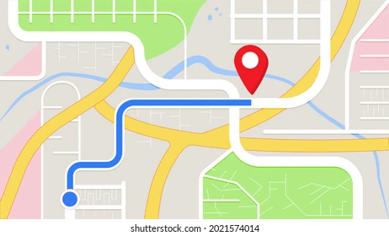

Are Failed Bookings Recovered?
Do customers immediately rebook after a failed ride?
Same-day retry behaviour is extremely rare.
Most failed bookings are not immediately recovered
E.g. of the 1,725 customers who experienced multiple unsuccessful bookings, only 19 attempted another booking on the same day.
Unsuccessful bookings often translate into lost booking opportunities

Slide 7
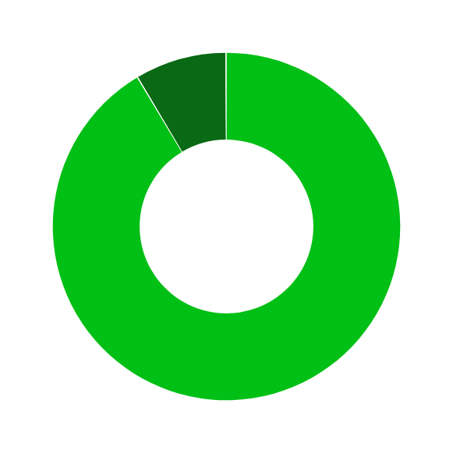



Repeat Customer Behaviour
Among 94,544 customers
7,954
Repeat
Customers
(8.4%)
86,590
One-time
Customers
(91.6%)
At least 1,725 customers repeatedly experienced unsuccessful bookings, which an evidence of consistent unmet demand
Among Repeat Customers
3,653
Only Successful
Bookings (45.9%)
1,725
Only Unsuccessful
Bookings (21.7%)
2,576
Mixed Outcomes
(32.4%)

Slide 8
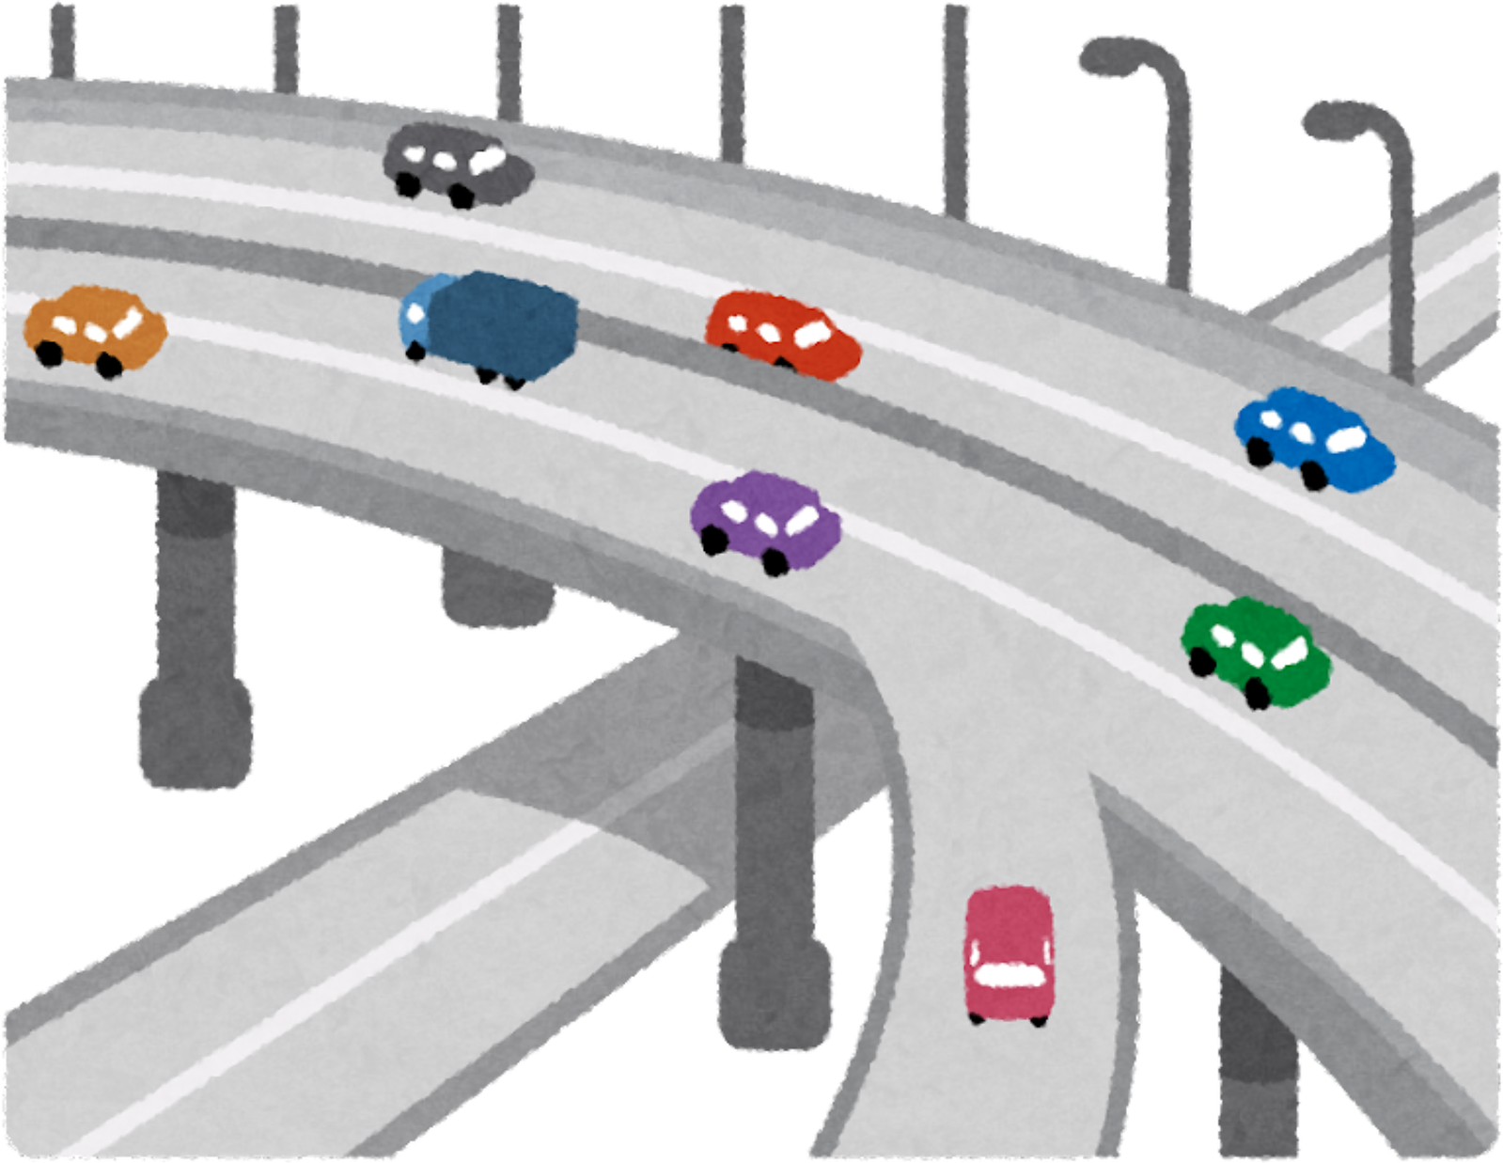
Are Customers Simply Retrying?
Most unsuccessful customers return on different days.
E.g. of the 1,725 customers who experienced multiple unsuccessful bookings, 1,071 customers repeatedly booked similar routes at similar times on different days.
The findings suggest the presence of persistent unmet demand.

Slide 9
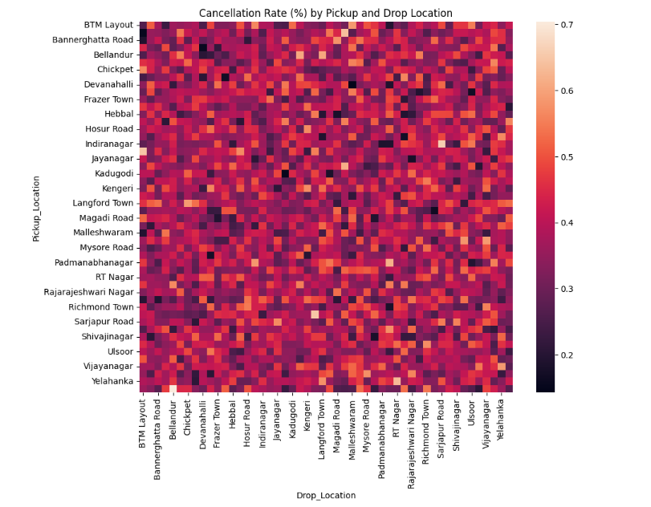

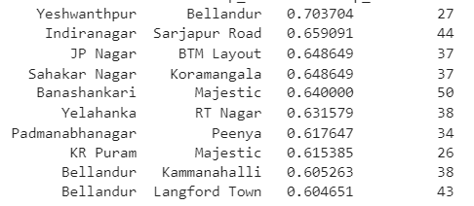
Route-Level Evidence
Do outcomes vary by location?
Failure Rate = (Incomplete + Driver Cancelled + Customer Cancelled + Driver Not Found) ÷ Total Bookings × 100%
Top 10 Failure Rate by Routes
Pickup Location
Drop Location
Failure Rate
Total Bookings
Note: Bellandur is a major IT hub, where high demand and severe congestion contribute to elevated booking failure rates.
Failure rate vary significantly across pickup-drop location

Slide 10








Operational Priorities
Focus areas to convert unmet demand into completed rides
1
3
2
4
Reduce
Driver Cancellations
Reduce
Vehicle Breakdowns
Focus on High-Failure Routes
Improve
Driver
Availability
Improve transparency, balanced penalty
Enhance vehicle reliability through maintenance partnerships and driver support programmes.
Reduce unmet demand on high-failure routes during peak hours via targeted non-cash driver incentives (e.g. vehicle maintenance vouchers)
Reduce supply-demand mismatch, reduce driver not found rate

Slide 11
Final Conclusion
Out of 103,024 booking requests, only 58.28% resulted in completed rides.
41.72% of booking requests failed to convert into completed rides, which represent more than 23.7 M in unrealised booking value.
The evidence suggests that operational reliability and supply availability are the primary constraints on successful rides
Improving driver reliability, service availability, and route level performance offers greatest opportunity to convert unmet demand into successful rides

